Slide 1

Diamonds Analysis
By: Pei Fong Lim, Qinwen Yang, Hao Hong Kua

Slide 2
Introduction of diamonds
What is a diamonds?
Diamonds known as the hardest materials on earth and diamond only can be scratched by the other diamonds
How diamonds were formed?
By combination of high heat and pressure, diamonds are formed within 100 miles away from the surface of Earth.
Why are diamonds so expensive?
Due to the complicated process of digging and finding it, that what make it so unique and expensive.

Slide 3
Dataset
What make a diamonds so expensive
Depth: Height of the diamond from culet to the table
Carat: Weight of the diamond
Cutting: Cut quality of diamond
Benefits
This dataset will benefit a buyer and a seller before they conduct a deal.
It will benefits all the women buyer to know what kind of diamonds they want.
It also will benefits all the men buyer to estimate their budget before they conduct ridiculous act.
Notes:
-

Slide 4
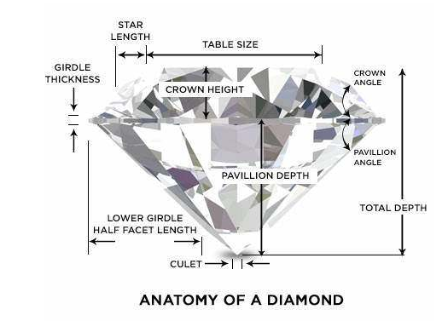

Slide 5
Dataset
Our dataset is from Kaggle.
Our dataset is a pre-made dataset.
Our dataset consist of 53137 diamonds.
To clean our dataset
Drop duplicates.
Drop unwanted column.
There is no exist of NaN-numbers.
Notes:
Drop x length, y width, z height, Unnamed column.

Slide 6
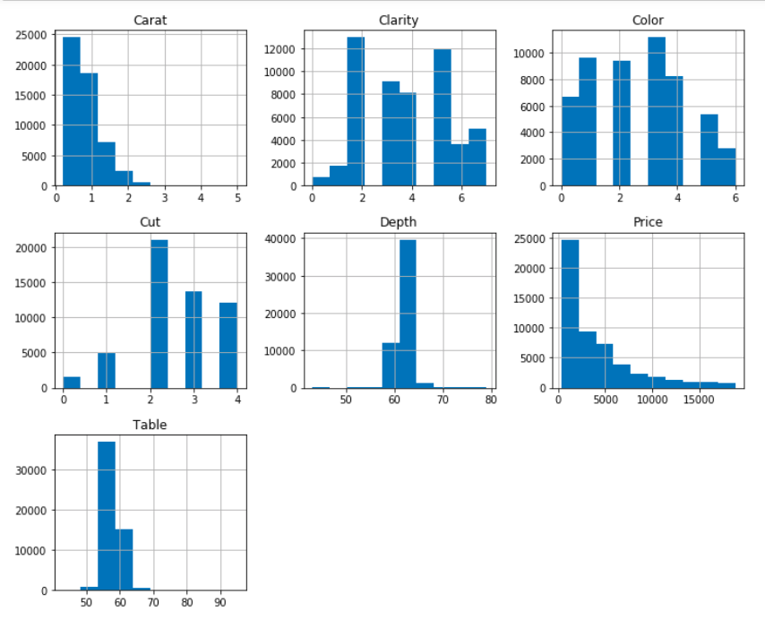
Histogram

Slide 7
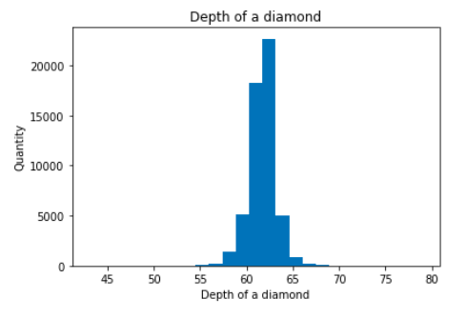
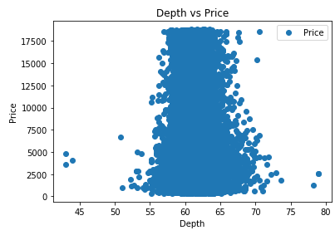
Exploration: Depth of Diamond
The quantity of diamonds purchase increase, when depth reaches between 60mm to 65mm.
Notes:
Fix: -Most diamonds are in depth between 60-65.
-The Price can vary heavily for same depth

Slide 8
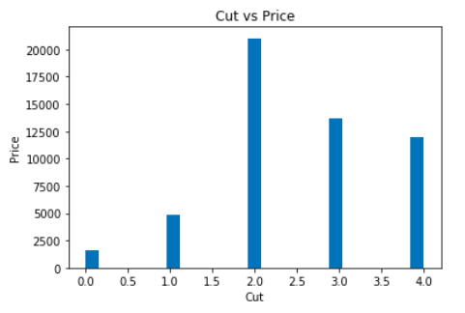
Exploration: Cut of Diamond
Cut:
Ideal: 2.0
Premium: 3.0
Very Good: 4.0
Good: 1.0
Fair: 5.0
Notes:
cut quality of the cut (Fair:5, Good:1, Very Good:4, Premium:3, Ideal:2)
Fair, Good, Very Good, Premium, Ideal

Slide 9
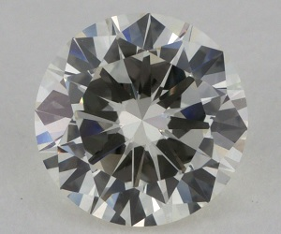
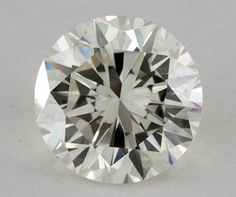

Slide 10
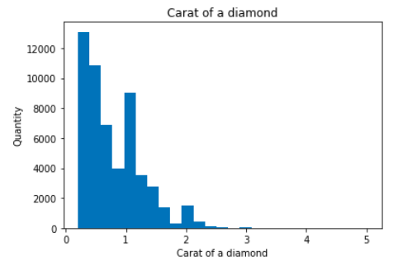
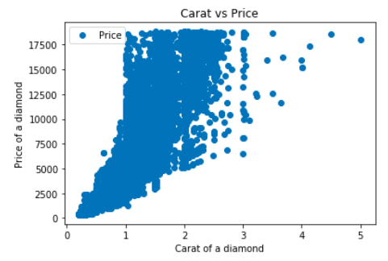
Exploration: Carat of Diamond
Price of a diamond can be affected not just by carat, it also will affected by cutting, color, depth and clarity.
Notes:
Fix:
-Most Diamond's carat are between 0 to 1.
-Carat varies with price exponentially, with a diamond in same carat, there are lot of different price, thus a diamond can be affected not just by carat, but also affected by cutting, color, depth or clarity.
-The larger the diamond, the rarer it becomes and such the price increases exponentially.

Slide 11
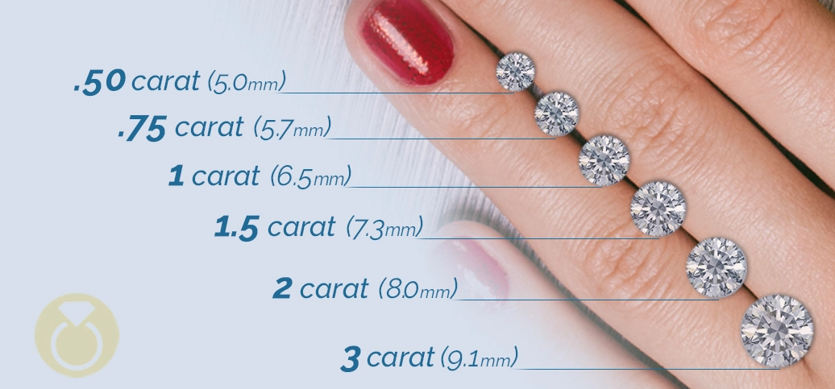

Slide 12
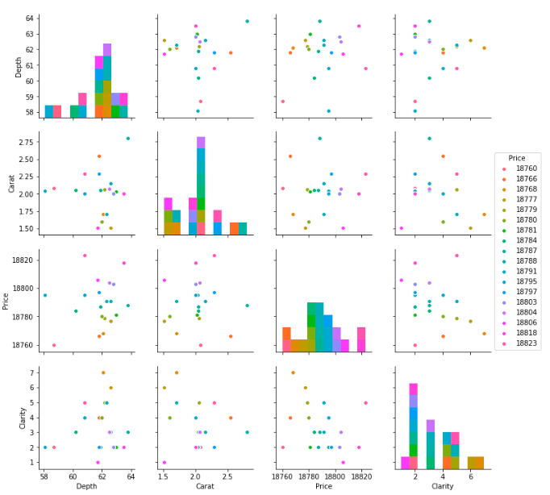
PairPlot
Top 20 price points of diamonds
Notes:
-Top 20

Slide 13



Training Method
Decision Tree Method
Linear Regression Method
KNN Method
Notes:
MAE: To measure how close the prediction.
MSE: An estimator measure the average square. (Average squared difference between these estimated value and what is estimated
Root MSE: Measure the different between values predicted by a model or estimator and the values observed.
X is independent variable, y is dependent variable
Splitting the data into 80% training set and 20 % testing set
Conclusion: DEcision Tree is the best because the MAE is the smallest.

Slide 14
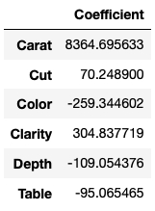
Coefficient
Notes:
Carat is the most significant factor that affects the price of the diamonds.
Next will be the clarity of the diamonds which also affect the diamonds price. This maybe due to the fact that diamonds with the absence of the Inclusions and Blemishes have better appearance, more brilliant.
Color is the least affecting factor on the price, because most popular color of the diamonds are white or colorless.

Slide 15
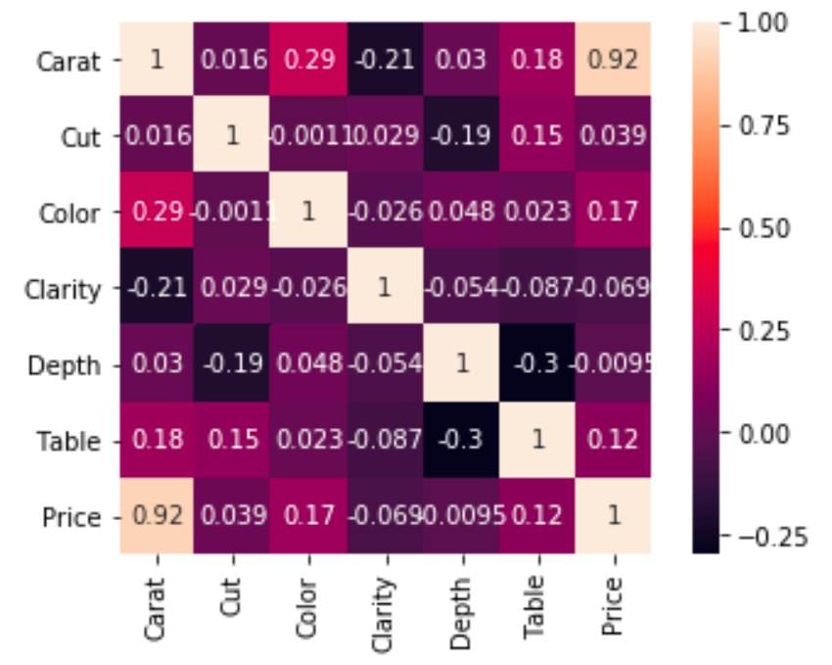
Correlation Map
Notes:
Carat is the most significant factor that affects the price of the diamonds.

Slide 16
Conclusion
Depth is inversely related to Price.
This is because if a 2Diamond's Depth percentage is too large or small the Diamond will become 'Dark' in appearance because it will no longer return an Attractive amount of light.
The Price of the Diamond is highly correlated to Carat, and its Dimensions.
The Carat (Weight) of a diamond has the most significant impact on its Price.
Since, the larger a stone is, the Rarer it is, one 2 carat diamond will be more 'Expensive' than the total cost of two 1 Carat Diamonds of the same Quality.
Notes:
Depth is inversely related to Price.
This is because if a Diamond's Depth percentage is too large or small the Diamond will become 'Dark' in appearance because it will no longer return an Attractive amount of light.
The Price of the Diamond is highly correlated to Carat, and its Dimensions.
The Carat (Weight) of a diamond has the most significant impact on its Price.
Since, the larger a stone is, the Rarer it is, one 2 carat diamond will be more 'Expensive' than the total cost of two 1 Carat Diamonds of the same Quality.

Slide 17
Thank you! Question?

